Slide 1
GCBASIC
PIC18FxxQ35chip Family
Part 14 - PWM many ways

Slide 2

GCBASIC
PIC18FxxQ35chip Family
Part 14 - PWM many ways

Slide 3
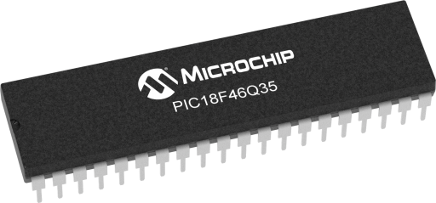
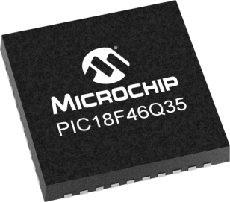
GCBASIC
Like and subscribe!

Slide 4
PIC18FxxQ35
PIC18FxxQ35 is a high performance PIC18
Digital and analog peripherals for flexible embedded control
10-bit ADC for accurate analog signal conversion
Multiple communication interfaces including UART (serial), I²C, and SPI
PWM modules with CCP and 16-bit resolution for precise timing and motor control
Configurable Logic Cells (CLCs) for custom hardware-level logic without external components
Integrated op amps for onboard analog signal conditioning and amplification
The PIC18FxxQ35 offers 28, 40 and 44-pin products in small footprint packages to support customers in a wide variety of applications.

Slide 5
Videos...
Install the hardware and make the board work – make LEDs work
Make four LEDs flash in a sequence
Set the LEDs to represent the value of ADC
Sequence the LEDs with a delay using the value of ADC
Using an input to set the state of the LEDs
Using the reset switch
Using the switch, ADC – make the LEDs flash in a sequence with reverse
Using the serial to display values
Using the timer0 overflow, 8bit timer, 16bit timer to flash the LEDs
Using EEProm – showing values on the serial terminal, and more constants insights
Using I2C with serial to discover I2C devices
Using an I2C GCLD display
Using a SPI GCLD display
Using PWM, many ways, to dim the LEDS
Using an external interrupt to control an LED
Using storage within the chip – Progmem, SAF memory, EEPROM and DATA blocks
Using CLC
The GCBASIC tool chain
Assembly , alternatives assemblers and MPLAB-X
Summary

Slide 6
GCBASIC Compiler
GCBASIC Compiler
GCBASIC is an Open Source compiler for PIC, AVR and LGT microcontrollers
GCBASIC now supports the 18FxxQ35 chip family
GCBASIC now supports 1400+ microcontrollers

Slide 7
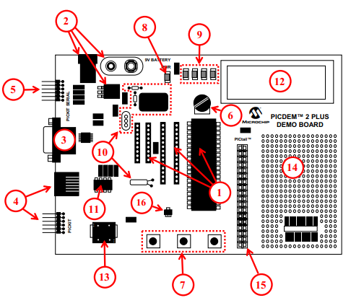
PICDEM 2 Plus Demonstration
Board
1. 18-, 28- and 40-pin DIP sockets
(although three sockets are provided, only one device may be used at a time)
2. On-board, +5V regulator for direct input from 9V, 100 mA AC/DC wall adapter or 9V battery, or hooks for a +5V, 100 mA regulated DC supply
3. RS-232 socket and associated hardware for direct connection to an RS-232 interface
4. Programmer/debugger connectivity supporting MPLAB® ICD 3, MPLAB REAL ICE and PICkitPlus
5. PICkit Serial Connector for analysis of serial communications peripherals such as SPI or I2C™
6. 5 k pot for devices with analog inputs
7. Three push button switches for external stimulus and Reset
8. Power-on indicator LED
9. Four LEDs connected to PORTB
10. On-board external oscillators including:
a) Unpopulated DIP socket for canned crystal oscillator (Y2)
b) RC oscillator circuit (R4, C3)
c) Unpopulated holes for crystal connection (Y1)
d) 32.768 kHz crystal for Timer1 clock operation (Y3) 11. 32K x 8 Serial EEPROM
12. LCD display
13. Piezo buzzer
14. Prototype area for user hardware
15. Expansion Header for PICtail™ daughter card connectivity or user access to MCU pins
16. Microchip TC74 thermal sensor
Plus SPI GLCD
3A

Slide 8
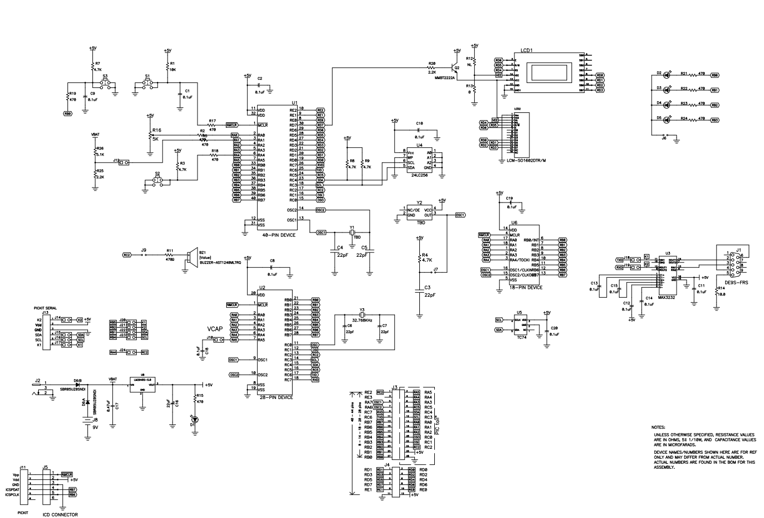
PICDEM 2 Plus Demonstration
Board

Slide 9
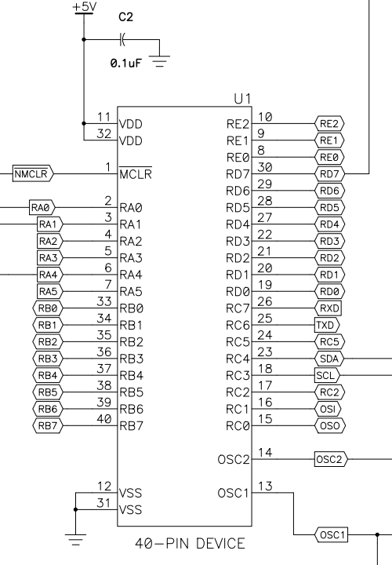
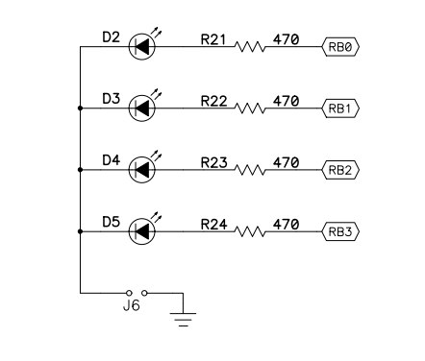
PICDEM 2 Plus Demonstration
Board
VDDIO2

Slide 10
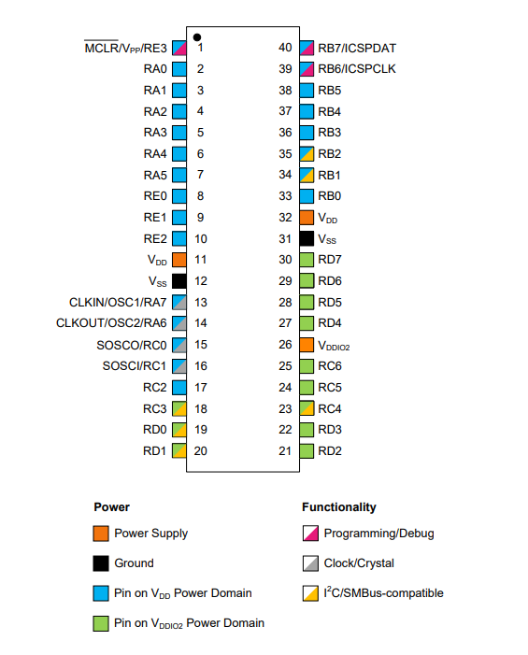
VDDIO2 Domain Power
Think No VDDIO2 power – no domain I/O!

Slide 11
Pulse Width Modulation
Pulse Width Modulation ( PWM ) is simply a succession of pulses – is a method of reducing the average power delivered by an electrical signal, by effectively chopping it up into discrete parts.
The average value of voltage (and current) fed to the load is controlled by turning on and off at a fast rate. The longer the signal is on compared to the off periods, the higher the total power supplied to the load.

Slide 13
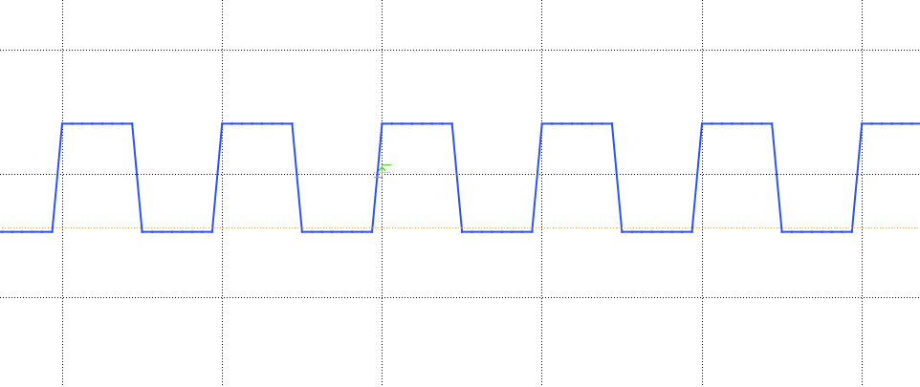
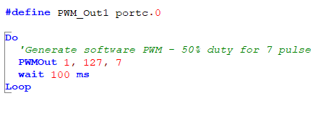
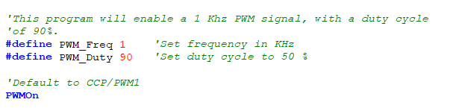
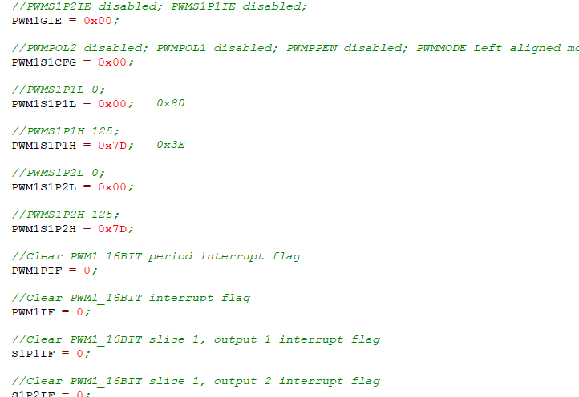
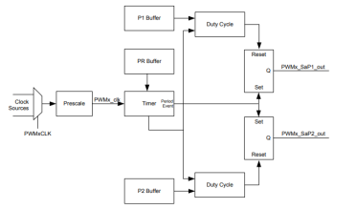
PWM

Slide 14
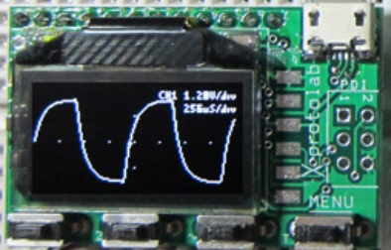
Setup
http://www.gabotronics.com/development-boards/xmega-xminilab.htm

Slide 15
PWM
 | PWM type | Characteristics | PPS required | Comment
1 | The simplest way | Port on and off | No | Any port**
2 | The pulseout() way | PulseOut() a port for a period | No | Any port**
3 | The PWMOut() way | PWMOUT() a number of pulses | No | Any port**
4 | CCP/PWM way | Fixed frequency, fixed duty using timer2* | Yes – CCP/PWMx module | Low code impact, two constants
5 | CCP/PWM way | Variable frequency, variable duty using timer2* | Yes – CCP/PWMx module | ASM does the heavy lifting
6 | PWM 16 bit way | Wide range of capabilities | Yes - PWMxx | Lots of parameters
7 | Timer interrupt way | Use a timer1* | No | Any port**
* could use other timers
** any valid output

Slide 16
Lab
Walk the examples
And, view the Xminilab scope

Slide 18
Videos...
Install the hardware and make the board work – three LED programs
Make four LEDs flash in a sequence
Set the LEDs to represent the value of ADC
Sequence the LEDs with a delay using the value of ADC
Using an input to set the state of the LEDs
Using the reset switch
Using the switch, ADC – make the LEDs flash in a sequence with reverse
Using the serial to display values
Using the timer0 overflow, 8bit timer, 16bit timer to flash the LEDs
Using EEProm – showing values on the serial terminal, and more constants insights
Using I2C with serial to discover I2C devices
Using I2C GCLD display solutions
Using a SPI GLCD display solutions
Using PWM, many ways, to dim the LEDS
Using millis()
Using storage within the chip – Progmem, SAF memory, EEPROM and DATA blocks
Using CLC
The GCBASIC tool chain
Assembly , alternatives assemblers and MPLAB-X
Summary

Slide 19
GCBASIC
PIC18FxxQ35chip Family
Part 14 - PWM many ways

